Slide 1
Neuromend
By Tempest
An ICT313 Games Technology Project
Ary Bizar, Anopan Kandiah, Hannah Klinac, Alex Mlodawski, Bryan Yu

Slide 2
Outline
Introduction
Project background
Client specification
The solution and the system
Project management
Technologies utilized
Video
Live demonstrations
Final status
Future possibilities
Lessons learned
Acknowledgements
Questions?

Slide 3
Introduction
Project Name: Neuromend
Client: Shri Rai, Murdoch School of Engineering & IT
Supervisor: Fairuz Shiratuddin
Tempest:
Ary Bizar (Bsc, Games Technology, Games Art and Design)
Level designer, Asset creator
Anopan Kandiah (Bsc, Computer Science, Games Technology)
Kinect development
Hannah Klinac (Bsc, Computer Science, Games Technology)
Leap Motion development, Project Manager
Alex Mlodawski (Bsc, Computer Science, Games Technology)
Kinect development
Bryan Yu (Bsc, Computer Science, Games Technology)
Razer Hydra development, Database

Slide 4
Project Background
Stroke
Parts of the brain may be damaged or may die
This can result some loss of motor control
One form of rehabilitation is rewiring
Rehabilitation
Accessibility
Money
Tedious/boring – no incremental goals
Limited
Notes:
HELPING PEOPLE

Slide 5
Client Specification
Client specification
Create a simulation that could have the same effect as current rehabilitation methods while potentially reducing the downsides
This project is essentially an evaluation step towards a more concrete implementation
Client requirements
Virtual Simulation
3 different exercises to demonstrate different movements
Using the given devices (explained next)
Sensitivity adjustor
Profiling and database to keep track of progress
Notes:
Project was initially created to evaluate the devices to see what could work well for a solution
Determined that the project was useful enough to be used in a practical setting
This project is essentially an evaluation step towards a more concrete implementation

Slide 6
The Solution
Virtual Simulation
3 different exercises that require different movements
Devices (providing different accessibilities) used in conjunction with Oculus Rift
Keyboard and mouse
Razer Hydra
Kinect
Leap Motion
Sensitivity and other adjustable settings
Provide incremental goals
Monitoring progress – can be assessed
Profiles on an external database

Slide 7
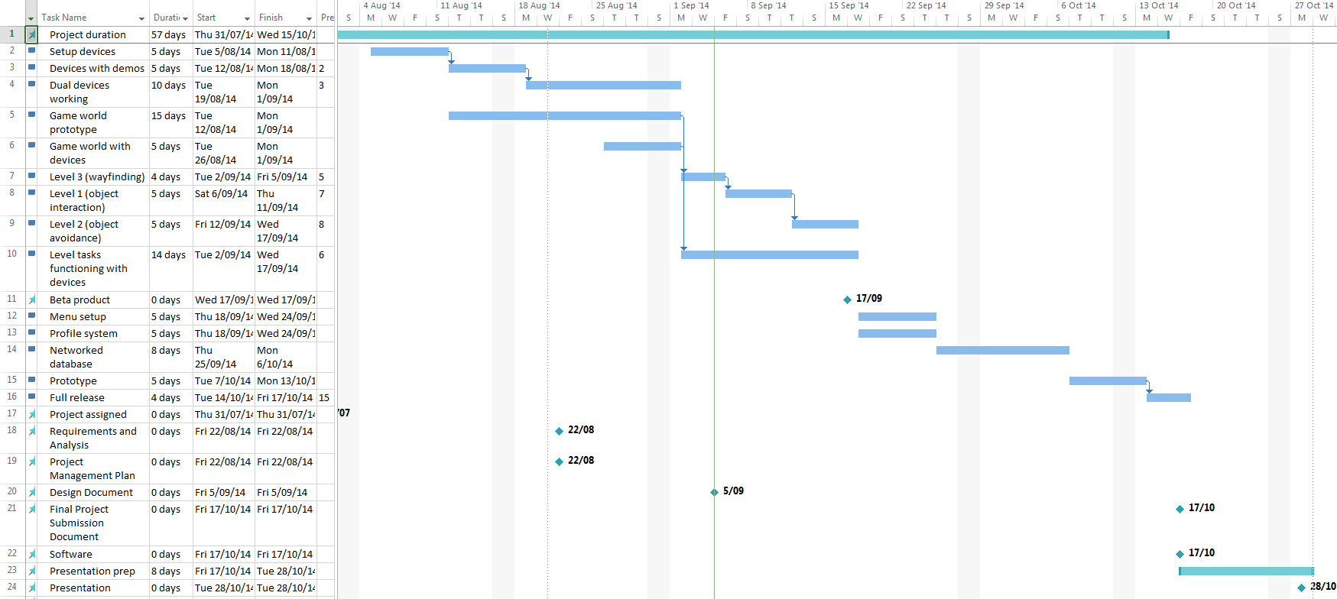
Project Management
Iterative SCRUM methodology with weekly sprints
Weekly team/supervisor meetings
Communication
Project room
Facebook group
Source code control
GitHub
Notes:
Weekly team meetings: discussed requirements, issues and demonstrated progress and prototypes
*How the project was managed
*How the team was managed
Work breakdown
Work assignment

Slide 8
Project Management
Ary Bizar – Level designer, Asset creator
Anopan Kandiah – Kinect development
Hannah Klinac – Leap Motion development, Project Manager
Alex Mlodawski – Kinect development
Bryan Yu – Razer Hydra development, database

Slide 9
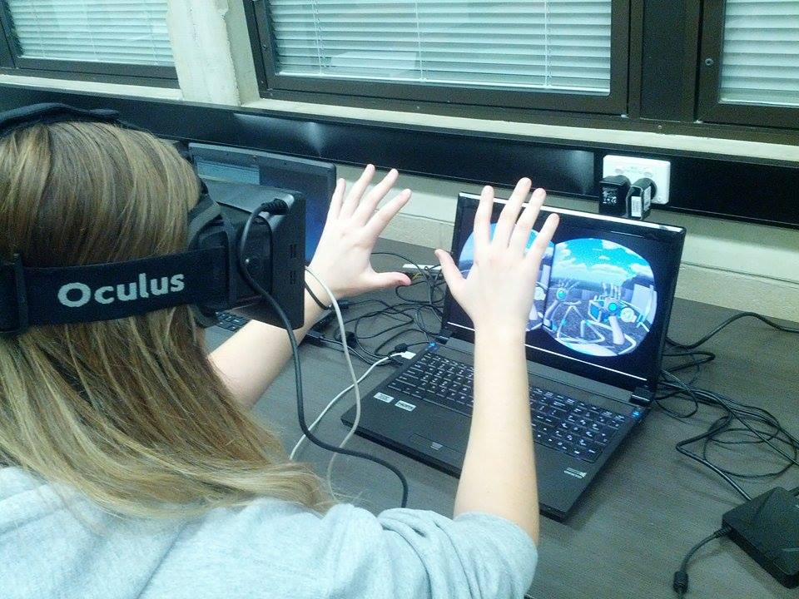
Technologies Utilized
Main system developed in Unity and coded using C#
Visual assets
3DS Max
Mudbox
Photoshop
Database and profiling system
MySQL
ClearDB
Hardware
Oculus Rift DK1
0.4.0 SDK
Razer Hydra
Sixense SDK
Kinect v1 for Windows
V1.8 SDK
Leap Motion
V2 Tracking API, 2.1.5 SDK

Slide 10
Video
Menu
Adjustors
Profiling
Oculus Rift – To make it easier for the audience to view, we’re only using the Oculus with one of the input interfaces today

Slide 11
Live Demonstration Kinect – “Object Avoidance” exercise
Object Avoidance
Kinect actions
Able bodied
Heightened sensitivity

Slide 12
Live Demonstration Razer Hydra – “Object Manipulation” exercise
Object Manipulation
Razer Hydra actions
Able bodied
Heightened sensitivity

Slide 13
Live Demonstration Leap Motion – “Way Finding” exercise
Way Finding
Leap Motion actions
Able bodied
Heightened sensitivity
Tracks all 10 fingers up to 1/100th of a millimeter
Beta product

Slide 14
Final Status
Requirements
Virtual Simulation
3 different exercises
Devices
Sensitivity adjustor
Profiling
Database
Playable by non-IT savvy people
Interesting and enjoyable
Extendable
The project is now in a position to be extended for deployment into practical use
PICTURE OF MAIN MENU

Slide 15
Future Possibilities
Clinical use
Client is in the process of setting up testing
Additional control schemes
Speech
EEG
Monitoring variables to self improve the system
Stress

Slide 16
Lessons Learned
Devices
Beta products
Driver clashes
Versions/compatibility
Designing the exercises and the movements/gestures to meet requirements and but to also consider the devices and what they can do
Version control and modifying joint code
Communication is essential for success
The importance of time management
Assess and managing scope

Slide 17
Acknowledgements
Client – Mr Shri Rai
Supervisor – Dr Fairuz Shiratuddin
Ayden-James Nolan – Music
Elly Thompson - Sounds

Slide 18
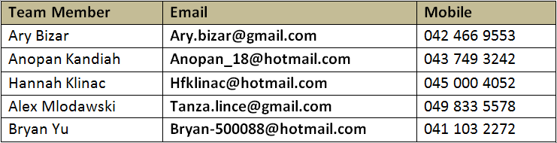
Questions?

